Slide 1
House Price Prediction
Manav Khambhayata
20BCS3413 (610-B)

Slide 2
introduction
We all know that a house price is a number from some defined assortment, so obviously prediction of prices of houses is a regression task. To forecast house prices one person usually tries to locate similar properties in his or her neighbourhood and based on collected data that person will try to predict the house price.
That is where Machine Learning comes.

Slide 3
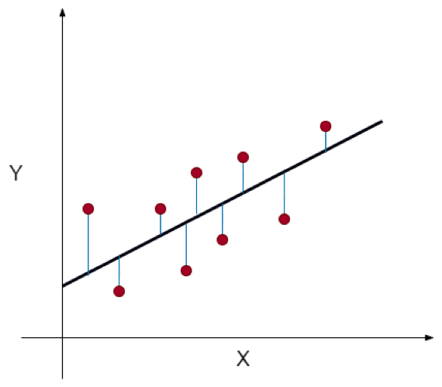
Linear regression
Y= a₀+a₁X+ ε
Y = Dependent Variable
X = Independent Variable
a₀ = Intercept of the line that offers additional DOF or degree of freedom.
a₁ = Linear regression coefficient, which is a scale factor to every input value.
ε = Random error

Slide 4
Problem status
A real estate agents want the help to predict the house price for regions in the USA. He gave you the dataset to work on and you decided to use Linear Regression Model. Create a model which will help him to estimate of what the house would sell for.

Slide 5
Dataset
Dataset contains 7 columns and 5000 rows with csv extension.
The dataset contains the following columns: -
• 'Avg. Area Income': Avg. Income of householder of the city house is located in.
• 'Avg. Area House Age': Avg. Age of Houses in same city.
• 'Avg. Area Number of Rooms': Avg. Number of Rooms for Houses in same city.
• 'Avg. Area Number of Bedrooms': Avg. Number of Bedrooms for Houses in same city.
• 'Area Population': Population of city.
• 'Price': Price that the house sold at.
• 'Address': Address of the houses.

Slide 6
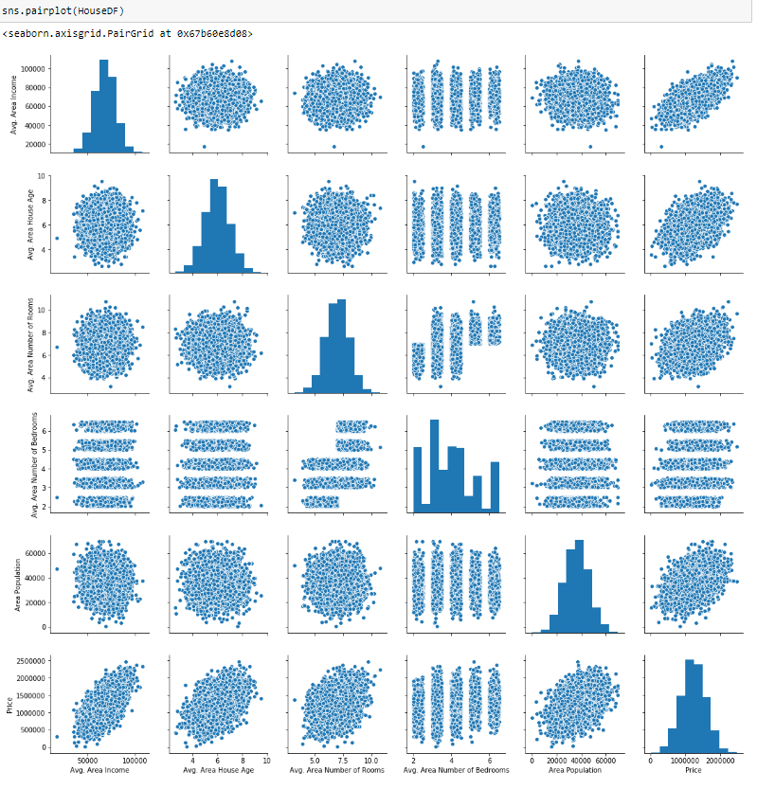
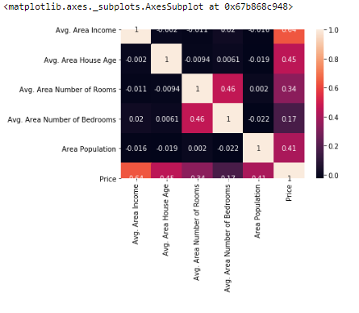
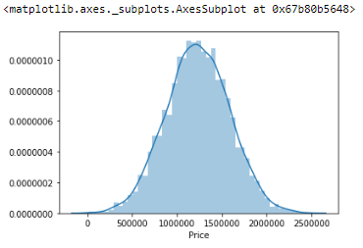
Exploratory Data analysis

Slide 7
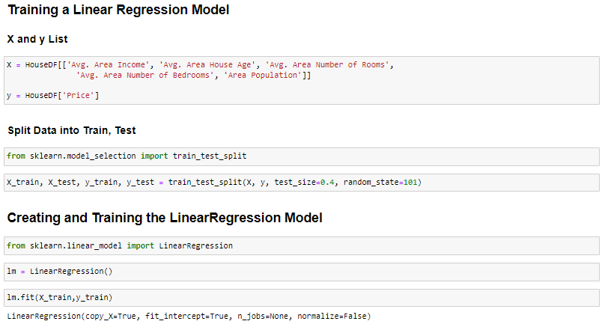
Training the model

Slide 8
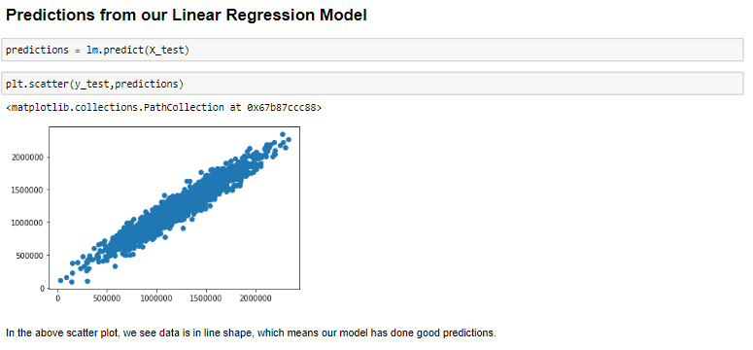
Predicting the result

Slide 9
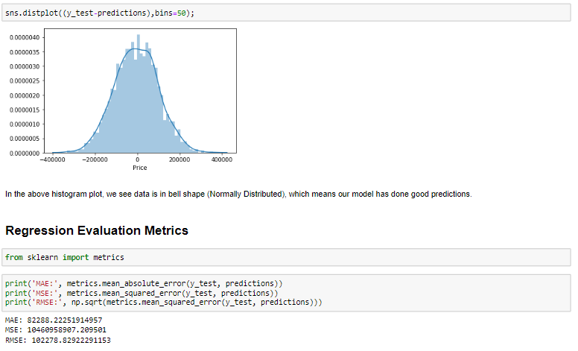
result

Slide 10
Thank You
MANAV KHAMBHAYATA
20BCS3413
610-B
CHANDIGARH UNIVERSITY

